Slide 1
Writing Software Requirements
SE- FALL 2017 BSCS V
CS & ENG. AUMC

Slide 2
Syntax and Defintion
A requirement is a statement expressing a need and its associated constraints and conditions.
A requirement clearly states something that the system is expected to do.
A requirement is written in natural language. When using a structure language with
clearly defined syntax and vocabulary, requirements are said to be semi-formal. In this
course, we will only consider semi-formal requirements. A requirement comprises at
least:

Slide 3
• a subject: what is the subject of the requirement?
• a verb: what shall be done by the subject?

Slide 4
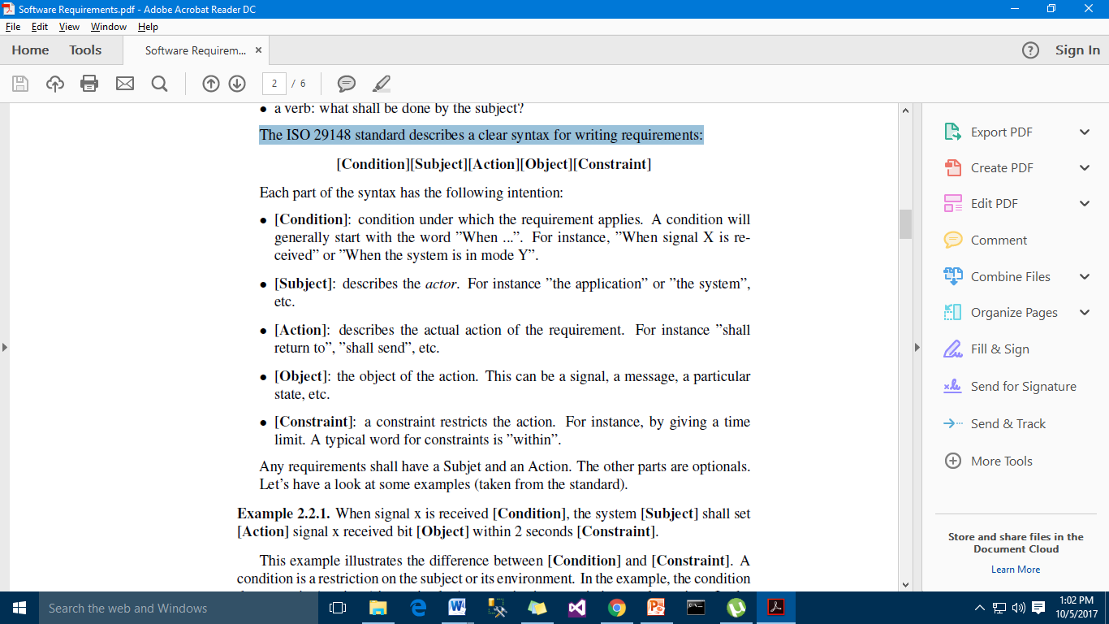
The ISO 29148 standard writing requirements:
The ISO 29148 standard describes a clear syntax for writing requirements:

Slide 5
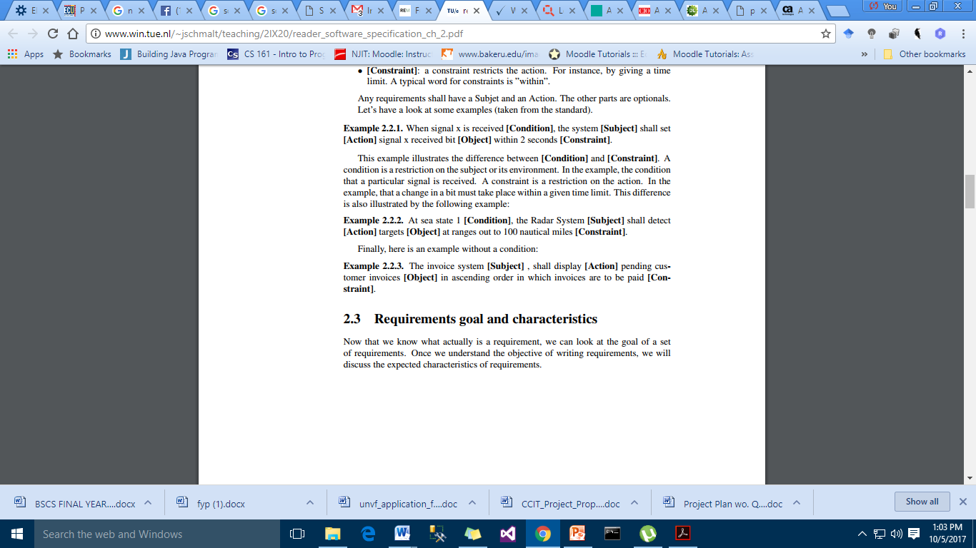

Slide 6
Characteristics of individual requirements
Implementation Free
Unambiguous.
Singular.
Consistent.
Traceable.

Slide 7
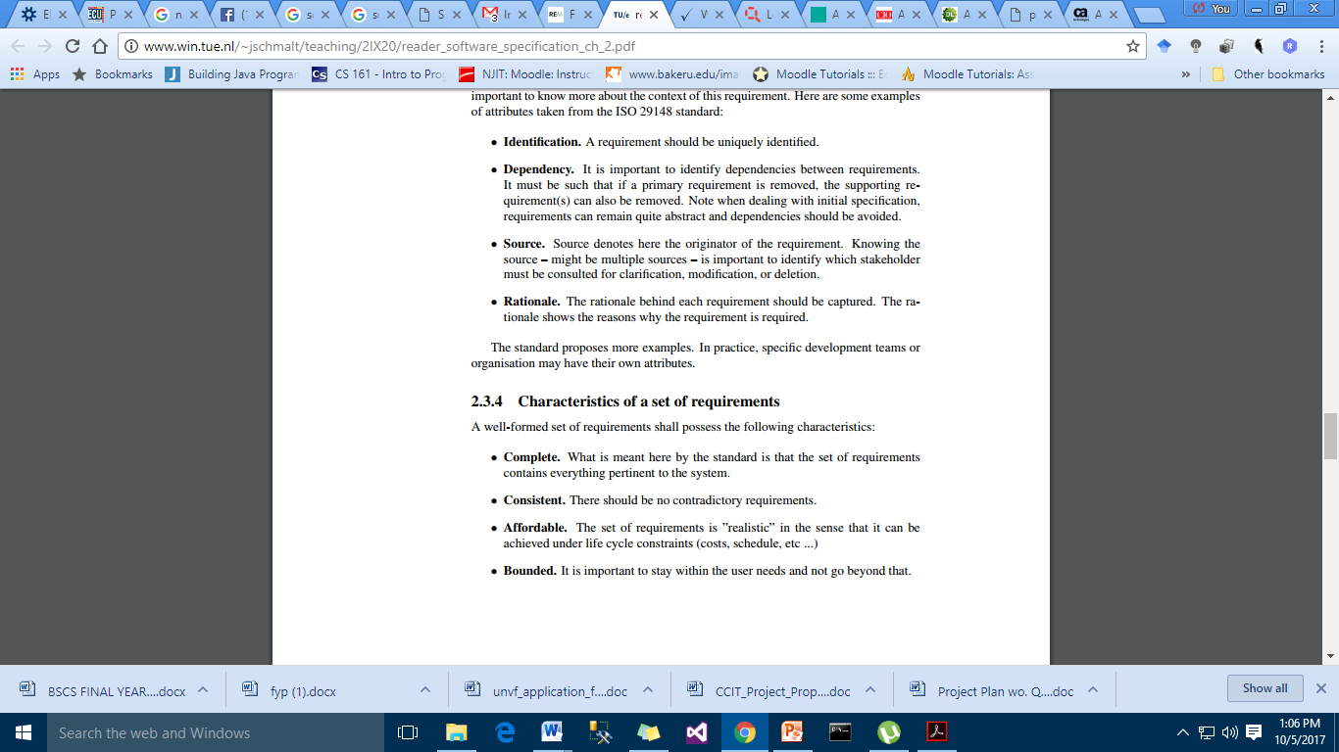
Attributes

Slide 8
Characteristics of a set of requirements
A well-formed set of requirements shall possess the following characteristics: •
Complete. What is meant here by the standard is that the set of requirements contains everything pertinent to the system.
• Consistent. There should be no contradictory requirements.
• Affordable. The set of requirements is ”realistic” in the sense that it can be achieved under life cycle constraints (costs, schedule, etc ...)
• Bounded. It is important to stay within the user needs and not go beyond that.

Slide 9
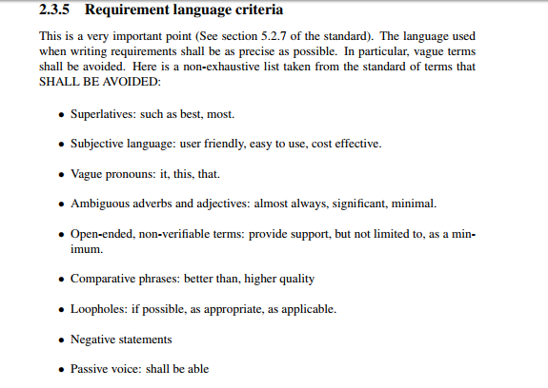

Slide 10
